Slide 1
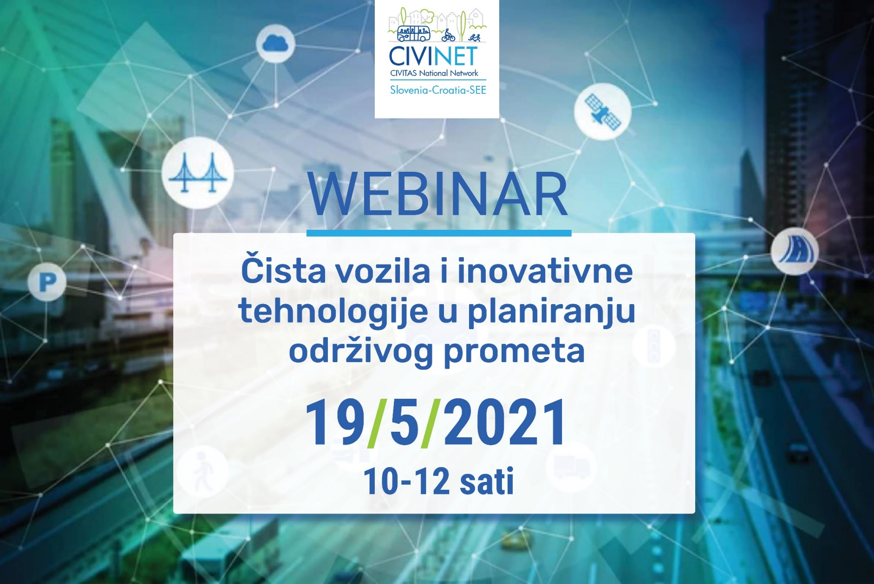
Električki avtobusi u gradskom prijevozu
Aleš Klinc, Municipality of Maribor

Slide 2
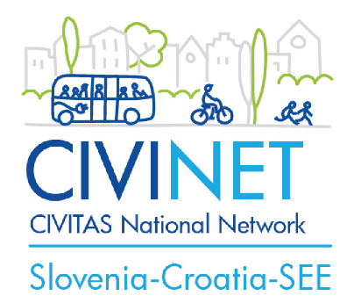
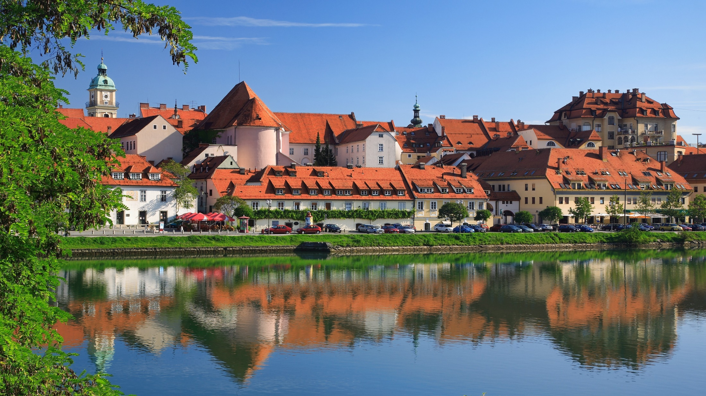

Električni avtobusi u gradskom prijevozu
MUNICIPALITY OF MARIBOR
CIVINET WEBINAR, 19.5.2021

Slide 3
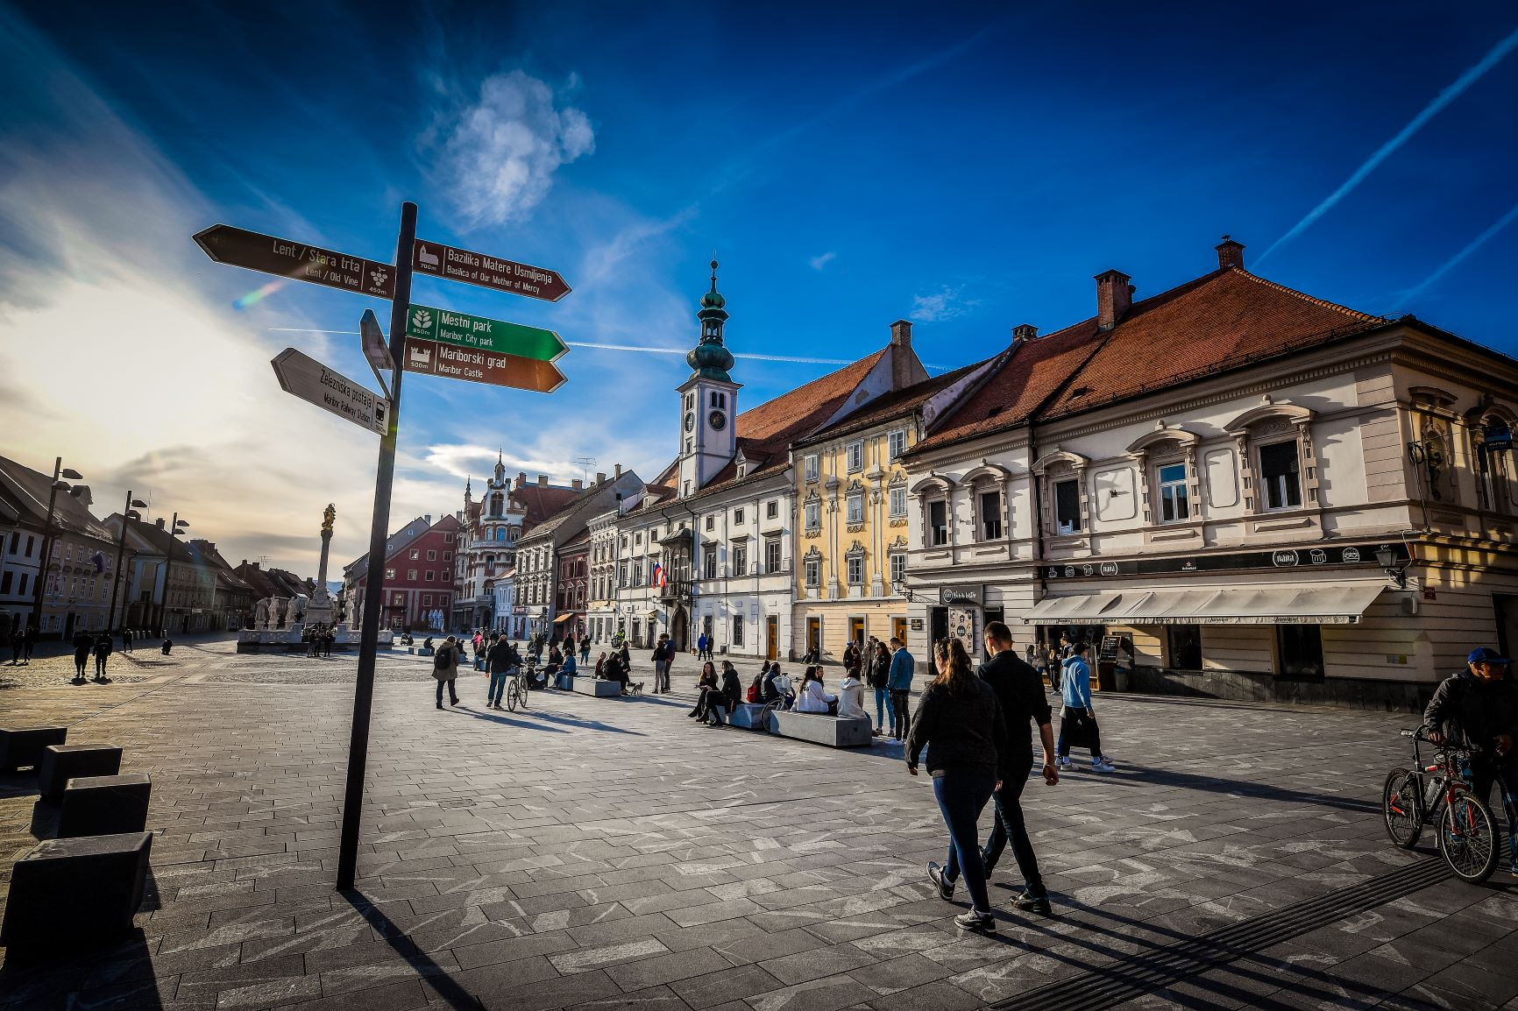
MUNICIPALITY OF MARIBOR
Municipality of Maribor (MOM) is the second largest city in Slovenia and the central local community in the Podravska region. (112000 inhabitants - 20000 students, 15000 schoolchildren), 147 m2
MOM is the public decision -making body for transport planning incl. infrastructure and is responsible for public transport infrastructure
Responsible: Public utility and traffic department
CIVINET WEBINAR, 19.5.2021

Slide 4
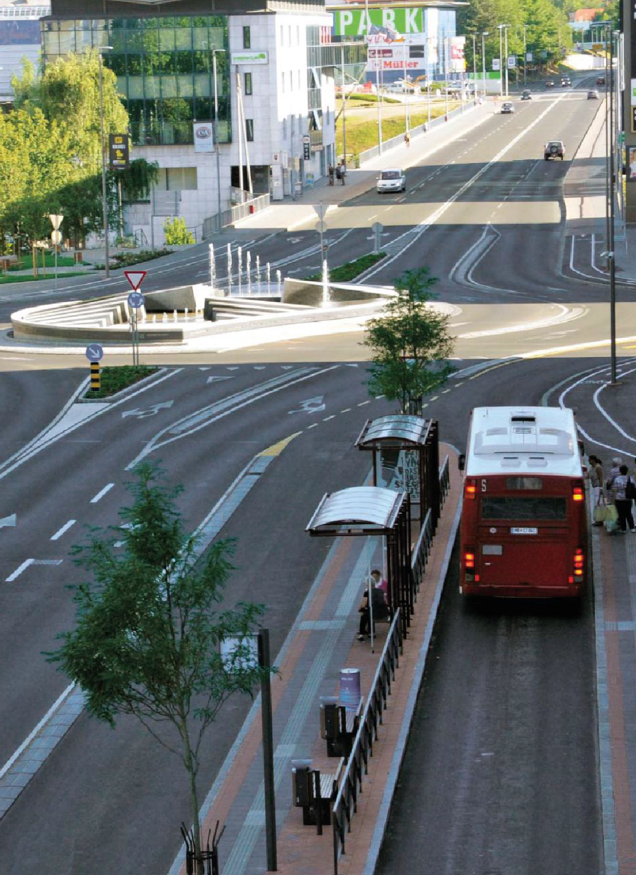
MUNICIPALITY OF MARIBOR – Strategic documents
SUMP – adopted by city council in august 2015
- no energent for bus service favorised
Increase quality of service (faster service (15 km/h), headway – 7 minutes on main corridors)
40 new buses (20 for replacement, 20 new)
- SEAP aim reducing the energy consumption of the transport system by 3%
CIVINET WEBINAR, 19.5.2021

Slide 5
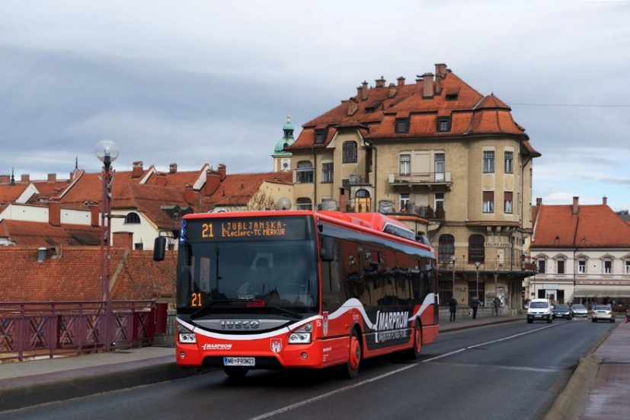
City bus service in Maribor
One municipaliy owned PT operator – MARPROM
21 city bus lines with 230 km total lenght
68 buses (capacity - 1.550 sits, 2.246 stands)
70,6 % diesel buses, 26,4 % CNG, 3 ebus – pedestrian zone, 1 electric hybrid
Avarage age of buses 11,3 in 2014; 5,8 in 2018
121 drivers
2,8 mil km on yearly basis
Budget 6,3 mil. € (Subsidy 4,1 mil. €)
Standard | Number
EURO 1 | 0
EURO 2 | 0
EURO 3 | 5
EURO 4 | 8
EURO 5 | 12
EURO 5 EEV | 2
EURO 6 | 40
Electric (mini) | 3
SUM | 68
CIVINET WEBINAR, 19.5.2021

Slide 6
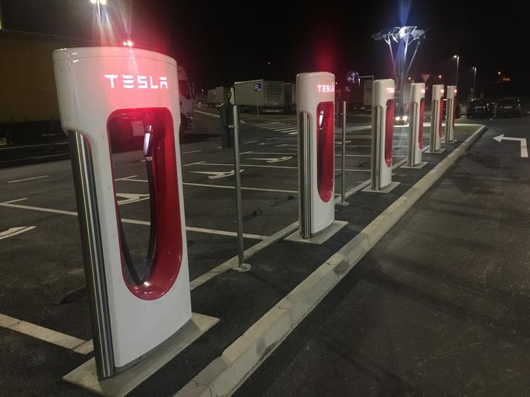
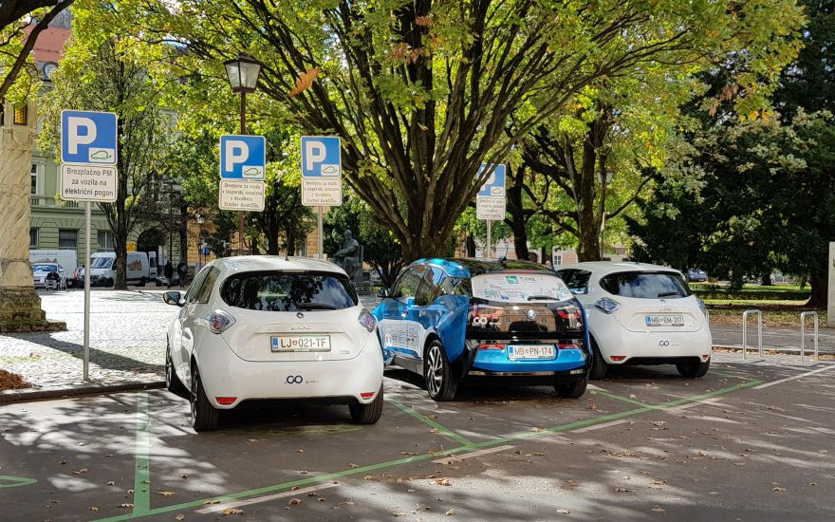
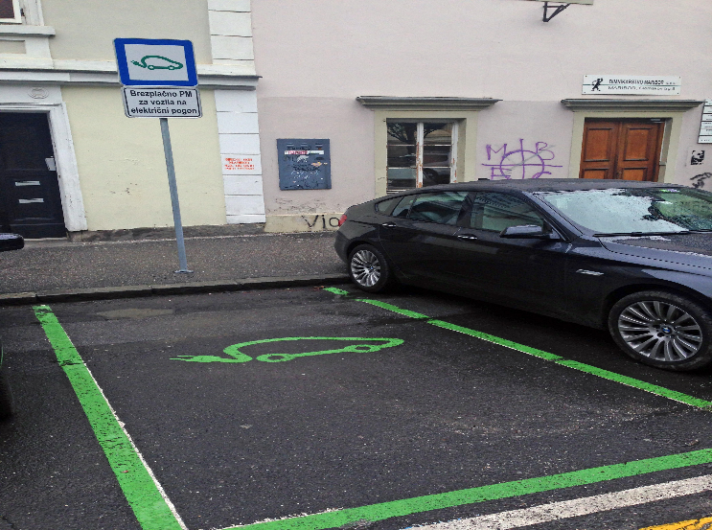
Context information –
Maribor‘s efforts for electromobility
first fast-charging station – 2012
56 e-car sharing spots in MB,
180 in Slovenia)
20 fast EV charging stations + 6 Tesla EV chargers
Additional 23 fast EV charging station planned in 2021
62 free parking for EV
AVANT CAR – 100% CAR SHARING system
CIVINET WEBINAR, 19.5.2021

Slide 7


Context information - Maribor‘s efforts for electric PT
2014 ELIPTIC, activities for electrifying PT (Electrifying PT route 6)
2019 EFFICIENCE,
CIVINET WEBINAR, 19.5.2021

Slide 8
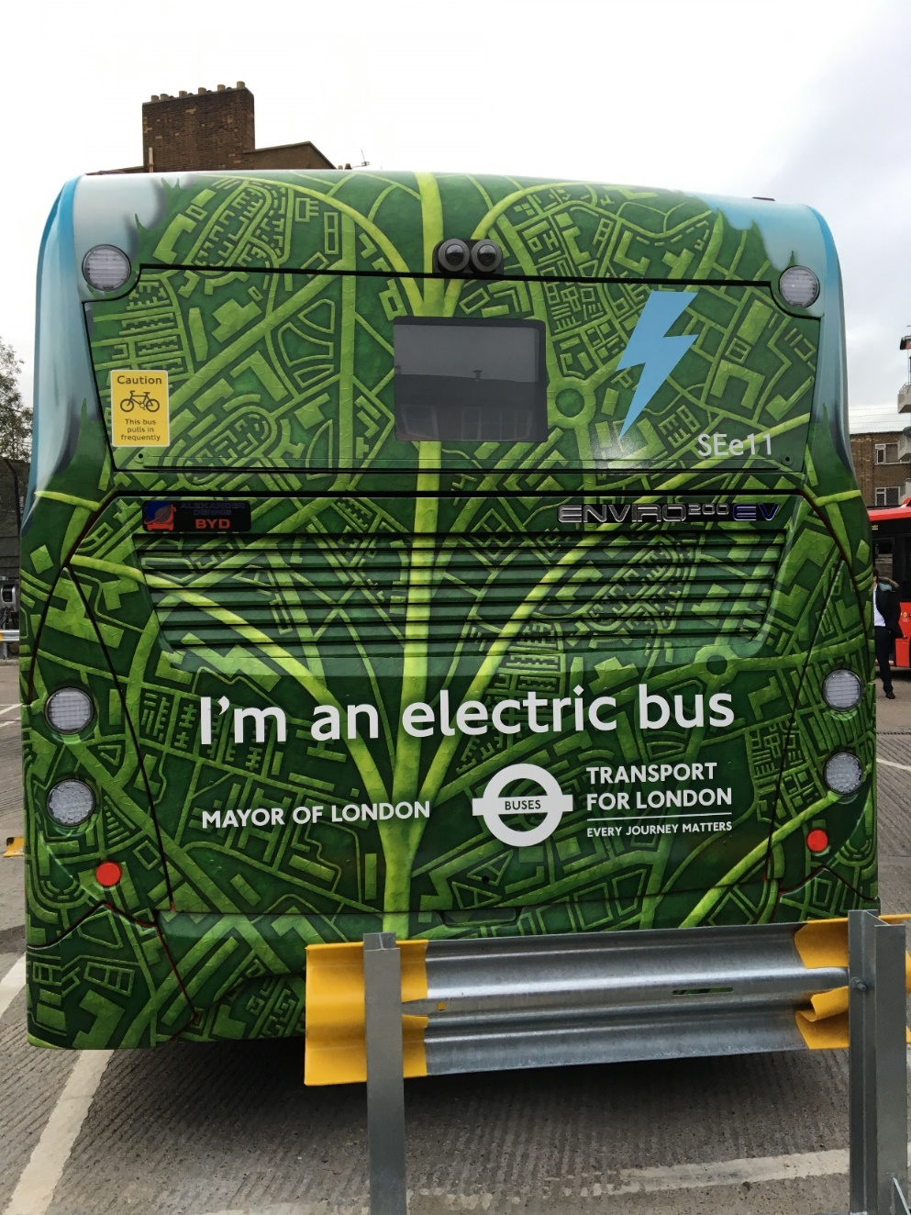
EXPECTATIONS FROM THE PROJECT ELIPTIC
Best practice examples from other cities (London, Berlin, Madrid, Budapest, Oberhausen, Bremen, Gdynia…)
Costs/savings
Impacts (economic, environmental, operational)
Administrative procedures
Technical characteristic
Transferability
Evidence based approach (scientific view)
Real-life experience
CIVINET WEBINAR, 19.5.2021

Slide 9
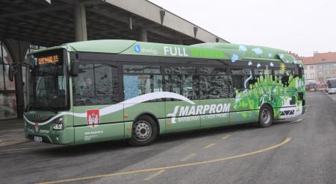
Testing
EU project ELIPTIC – 2014-2018
Hybrid bus (Iveco Urbanway electric hybrid) testing in 2016 –
Since may 2018 in operation
25 % less fuel consumption than diesel/high investment and maintenance cost
CIVINET WEBINAR, 19.5.2021

Slide 10
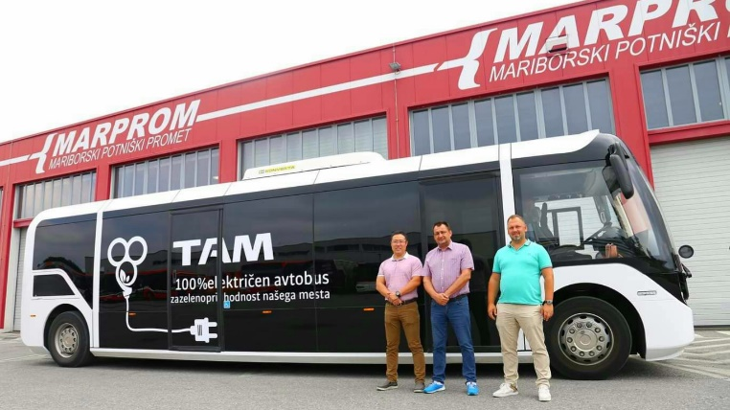
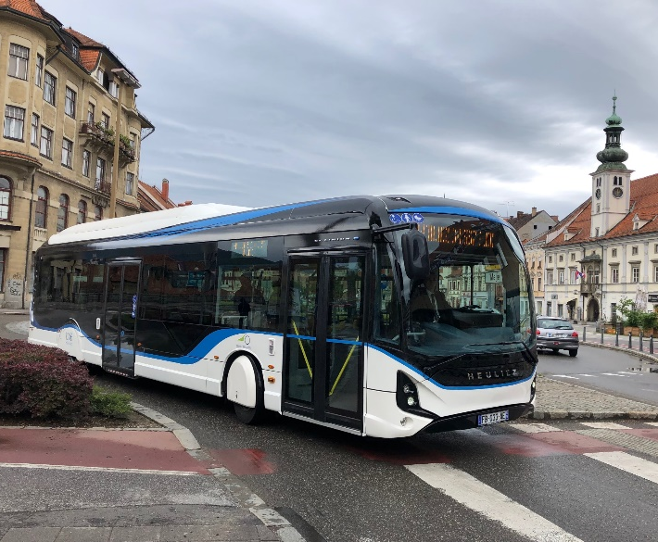
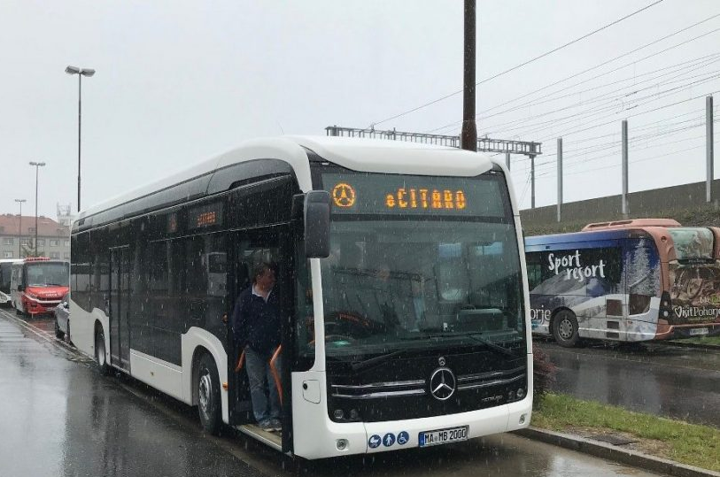
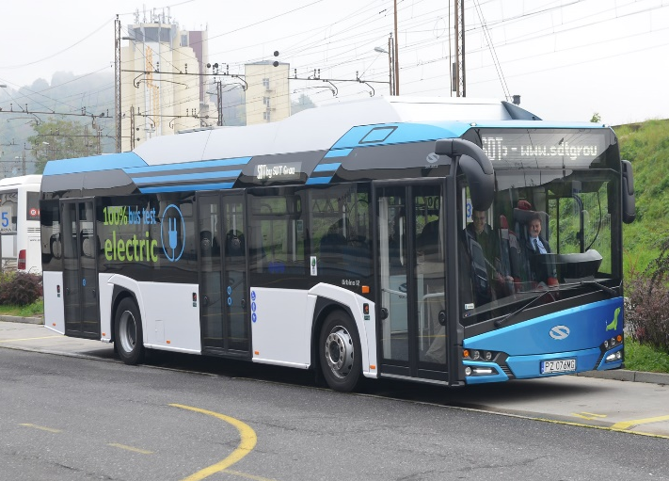
Testing
EU project ELIPTIC – 2014-2019
E-bus (Solaris Urbino – full electric) - testing in 2017 –
  average consumption 1,1 kWh/km,
  impact of heating (up to 1,4 kWh/km),
  hilly terrain – no higher consumption E-Bus
E-bus (HEULIEZ IVECO – full electric) – testing in 2019
E-bus (TAM Vero, Mercedes eCitaro, MAN Lions City E) in 2020, 2021
CIVINET WEBINAR, 19.5.2021

Slide 11
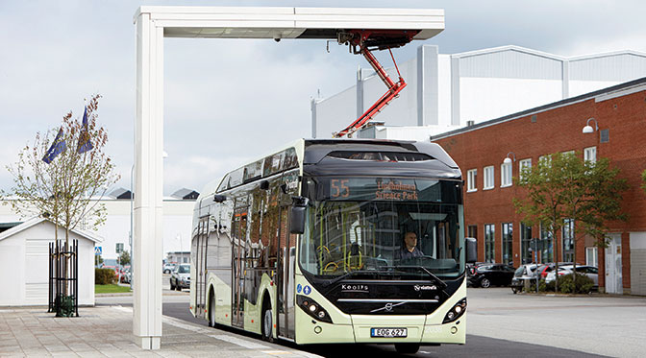
E-bus – experience
- Not succesfull public procurement of 5 plug-in electric buses in 2018
Is the market ready?
MOM started new project EFFICIENCE in 2019
CIVINET WEBINAR, 19.5.2021

Slide 12
CHALLENGES regarding PT infrastructure
Project EfficenCE, 2019 - 2022
  No common vision on Public transport infrastructure
  Finding optimal relation between batteries size and e-bus charging power/technology (LCC, efficency of the battery systems, additional energy storage for e-bus charges, smart grid)
  no real experience in using of full sustainable energy
  Administrative procedures for E-bus charging building and operating permit may slow down the implementation
  Vandalism
  Gauge (opp charger and oversized transport)
  Influence of weather on operations – cable car (full stop in cases of wind/ heavy rain – 2 to 3 times per year)
  Energy overload at bigger events (e.g worldcup in bike downhill, golden fox FIS SKI WOLRD CUP)
CIVINET WEBINAR, 19.5.2021

Slide 13
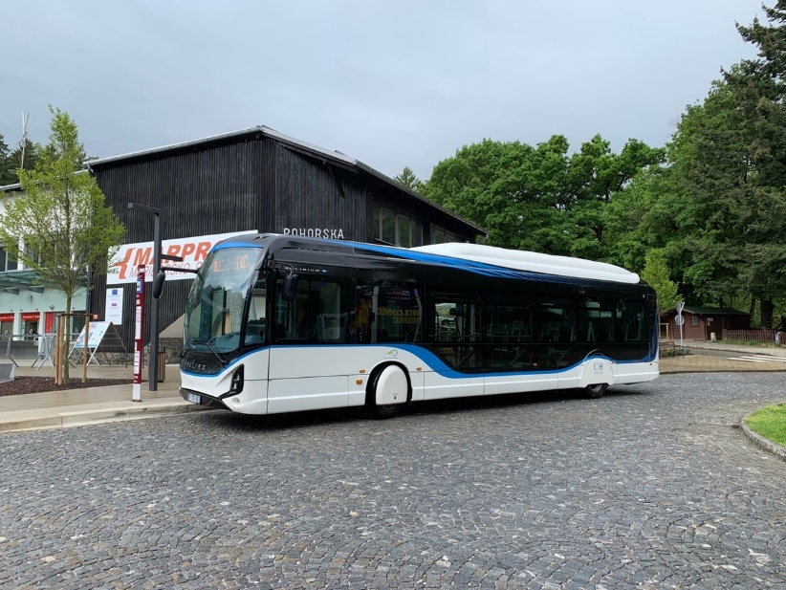
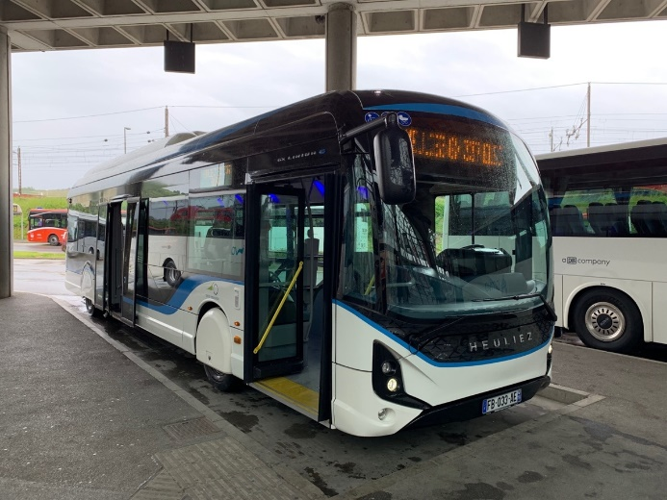
ROLE IN THE PROJECT
MOM
Aim is to partly electrify public transport (bus)
Action Plan of Multipurpose PT infrastructure
Investment in multipurpose PT infrastructure for cable car, e-bus, e-car on the the turning point of bus line 6
University of Maribor; The Faculty of Civil Engineering, Transportation Engineering and Architecture:
Support in the preparation of documentation for MOM
Testing a multipurpose PT infrastrucutre (together with MOM) according to the timetable and e-network stability
CIVINET WEBINAR, 19.5.2021

Slide 14
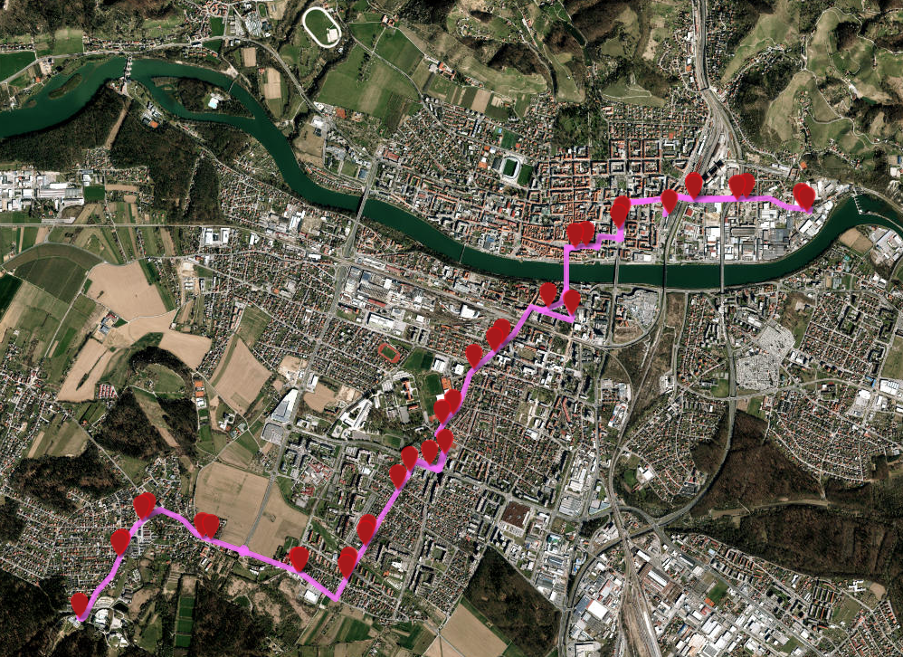
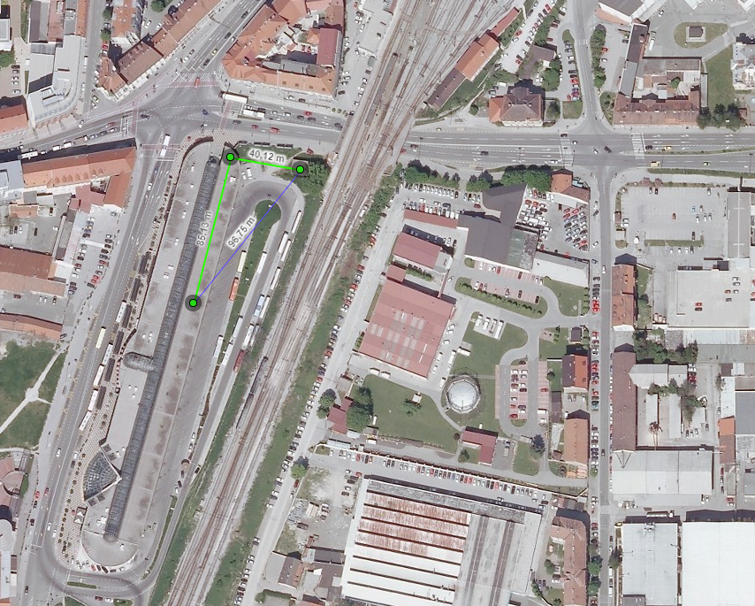
CITY/ PT NETWORK MAP – Line 6
TAKING COOPERATION FORWARD

Slide 15
MAIN ACTIVITIES – PROJECT PARTNER MOM and UMFGPA
Preparation phase MOM, UM FGPA and MARPROM (03.2020)
  investment documentation
  technical feasibility studies (upgrade of cable car substation, identification for e-bus charger and battery power)
  Concept of Multipurpose PT infrastructure
  Building and operation permit/planning permission
  call for tender (end of 2019)
Test phase (12 months leasing)
  incl. construction & connection to the grid works & public launch event (09. 2020)
Pilot evaluating
  energy performance indicators for energy-efficient PT infrastructure in Maribor & assessment of pilot transferability & replicability
  (10. 2021)
Purchase in 2021?, Evaluation report (03.2022)
CIVINET WEBINAR, 19.5.2021

Slide 16


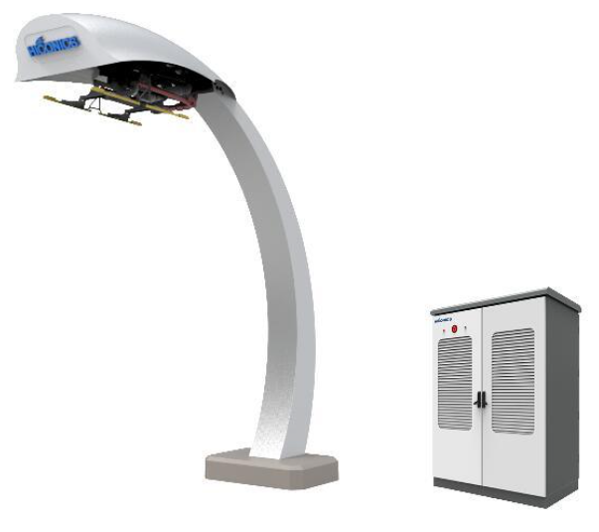
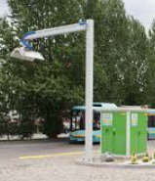
E-bus – comparison of technologies
Poznamo dva načina hitrega polnjenja:
Invertni pantograf (Panto down) | Pantograf na busu (Panto up)
1 Teža kontaktnih sani na e-busu ~7kg 2 Manj stroškov vzdrževanja avtobusa, vzdrževanja pantografov zunanji izvajalec 3 Cenejši avtobus, dražja polnilnica (170-210k€) 4 Ob nedelovanju pantografa, se avtobus polni na bližnjem pantografu 5 Kontaktne sani na e-busu so lahko katerekoli znamke/proizvajalca | 1 Teža pantografa na e-busu ~60kg 2 Večji stroški vzdrževanja avtobusov, vzdrževanje pantografov v delavnici 3 Cenejša polnilna postaja (130-160k€), dražji avtobus 4 Ob nedelovanju pantografa je avtobus neuporaben. 5 Pantograf na avtobus mora biti kompatibilen z infrastrukturo
CIVINET WEBINAR, 19.5.2021

Slide 17
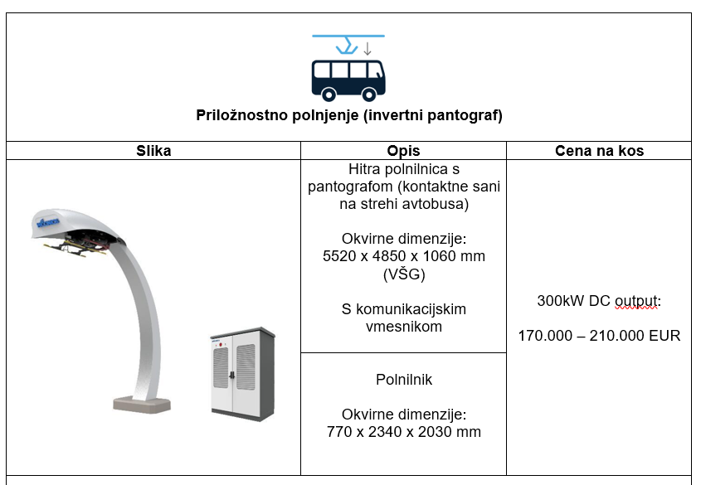
E-bus – selected option for Maribor
CIVINET WEBINAR, 19.5.2021

Slide 18
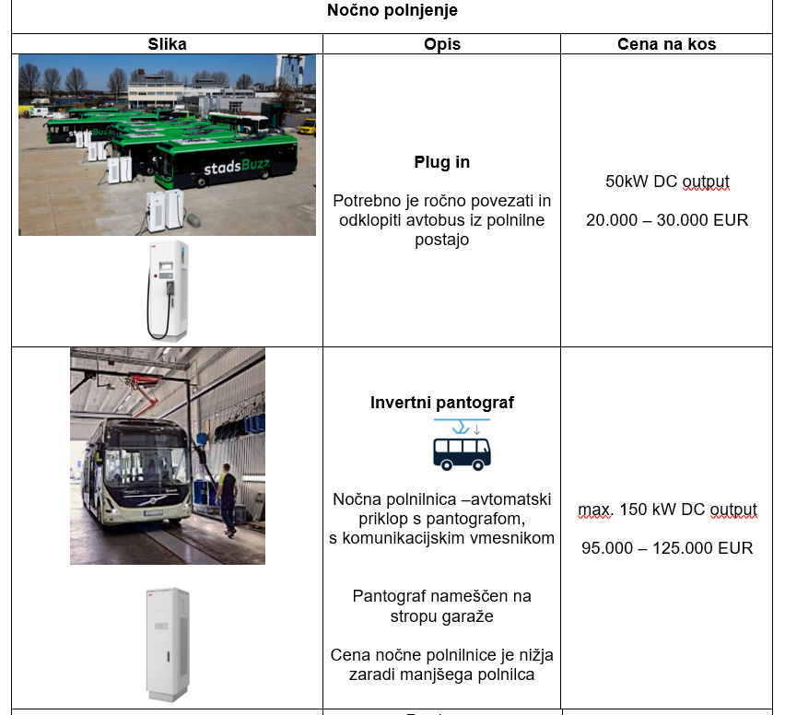
E-bus – selected option for Maribor
CIVINET WEBINAR, 19.5.2021

Slide 19
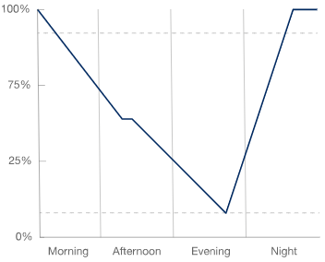
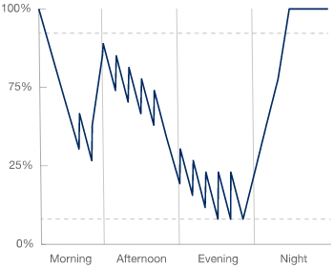
E-bus – comparison of technologies
Glavne razlike med nočnim in priložnostnim polnjenjem
Strategija polnjenja | Počasno (v delavnici) | Priložnostno polnjenje (v delavnici in čez dan)
Tip polnjenja | Delavnica: od 35 do 150 kW | Delavnica: od 35 do 150 kW Priložnostno: od 150 do 600 kW
Čas polnjenja | Delavnica: od 3 do 10 ur | Delavnica: od 3 do 10 ur Priložnostno: do 10 minut (na postaji)
Profil polnjenja (poenostavljeno)
Doseg | 100-200 km na dan | 200-500 km na dan
Stroški | 1 Višji stroški baterije 2 Cenejša polnilna infrastruktura | 1 Nižji stroški baterije 2 Dražja polnilna infrastruktura 3 Višji stroški vzdrževanja
CIVINET WEBINAR, 19.5.2021

Slide 20
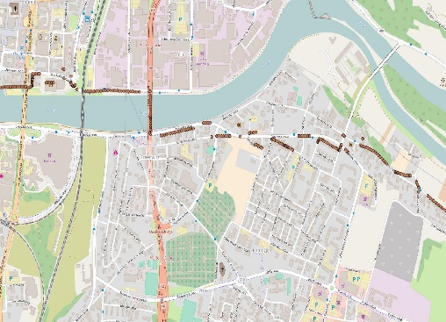
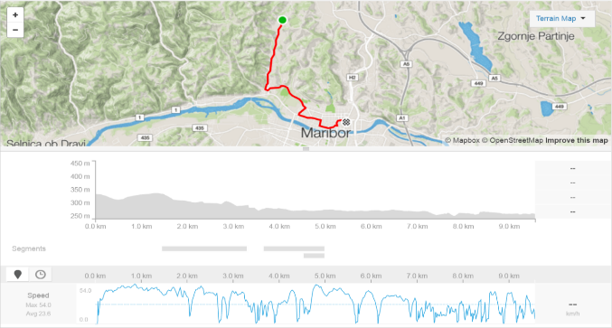
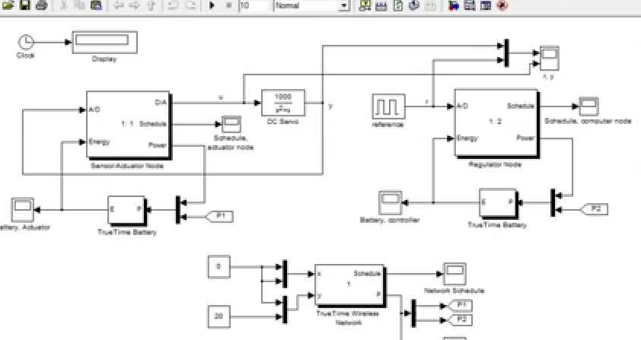
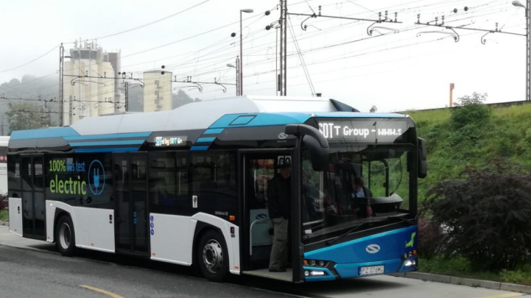
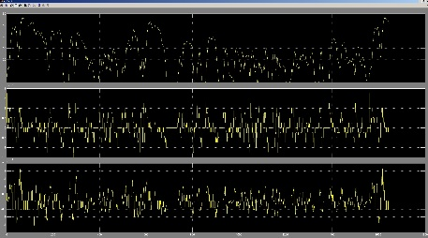
Current research
Simulation of driving cycle on line 6
Technical feasibility studies for e-bus charging infrastructure and E-buses
Investment documentation for 5 e-buses (12 m) and 3 e-fast Opp chargers
100 kWh batteries/ 200 kW e-chargers
GPS/GPX localisation
Speed diagram
Latitutde
Speed, Tourqe,
Power and battery size needed
with recuperation
Matlab Simulation
Vehicle parameters
CIVINET WEBINAR, 19.5.2021

Slide 21
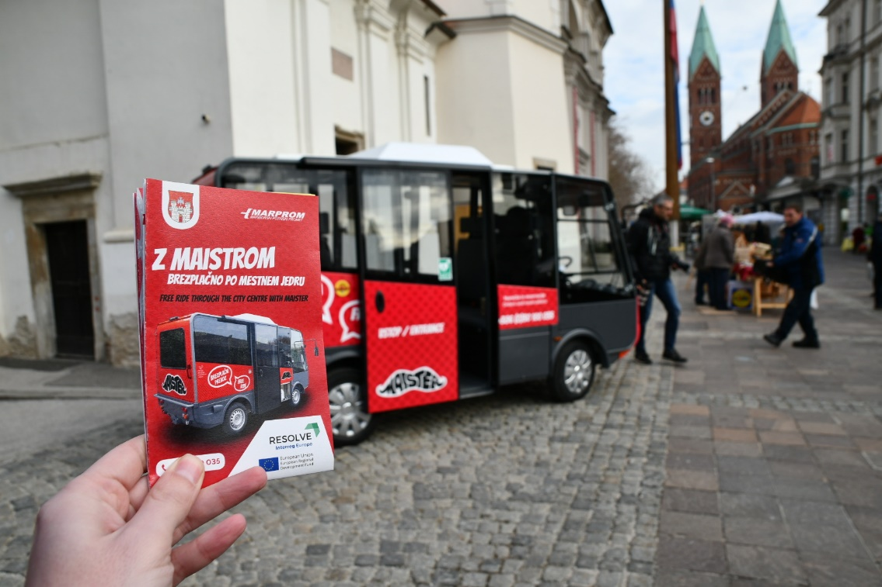
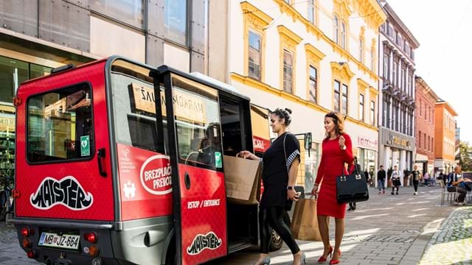
E-bus – now, 2021
city centre mini e-bus (since 2017), 3 in operation in 2021
CIVINET WEBINAR, 19.5.2021

Slide 22
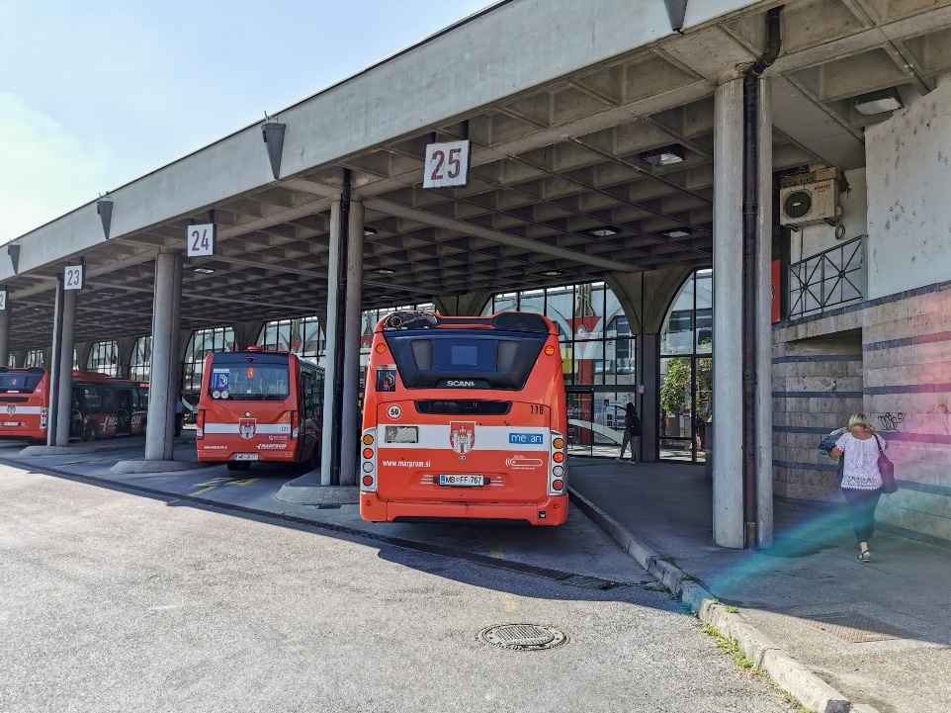
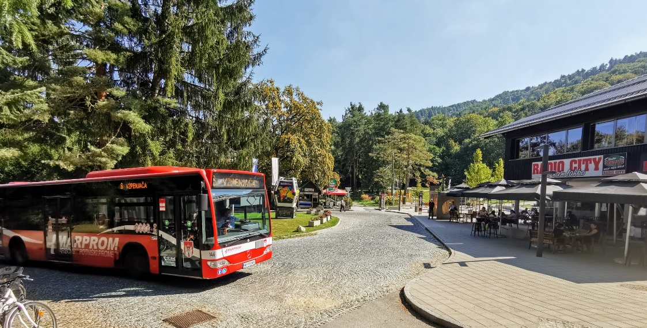
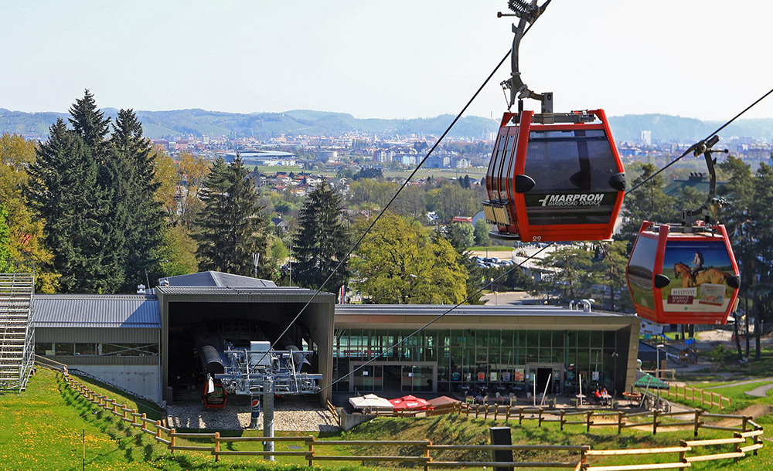
E-bus – now, 2021
public procurement for 5 full electric buses, JUNE 2021
Public procurement for 2 fast charger 150kW and 300kW, JUNE 2021
CIVINET WEBINAR, 19.5.2021

Slide 23

Thank you for your attention!
Aleš KLINC
ales.klinc@maribor.si
CIVINET WEBINAR, 19.5.2021

